Slide 1
Loan Performance Trend
June – August 2014
Fei Wang

Slide 2
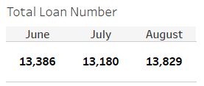
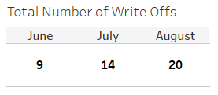
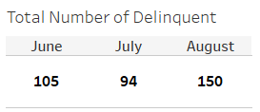
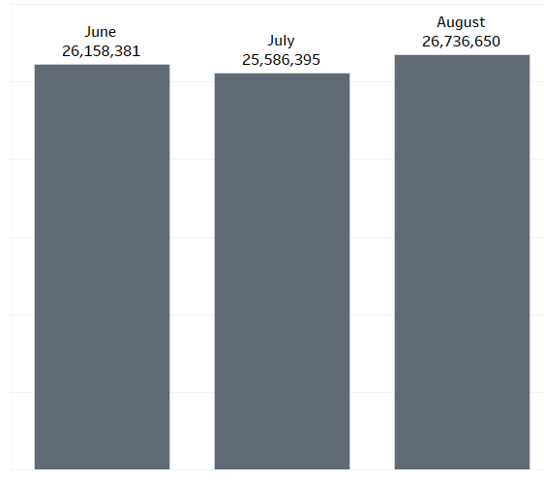
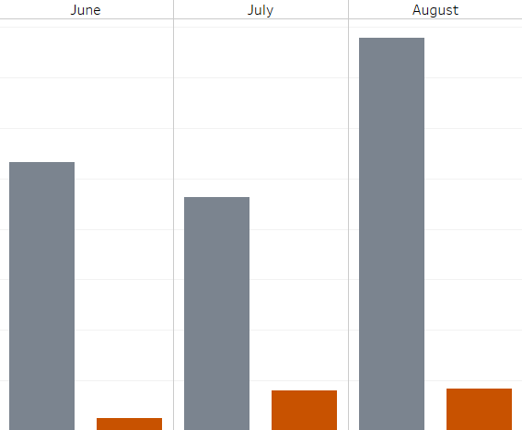

Total outstanding remained stable from June to July, then increased in August
Both delinquent and write-off amounts increased significantly in August.
Total Outstanding Amount
Delinquent & Write-Off Amount
$388,818
$266,295
$231,466
$40,065
$41,575
$12,422

Slide 3
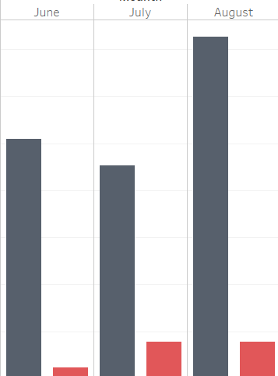
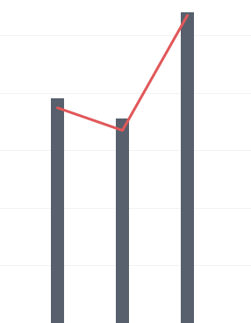

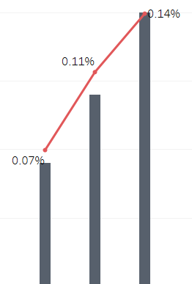
Delinquent & Write-Off Rate by Amount
Delinquent Rate by Number
1.454%
1.08%
0.78%
0.71%
Delinquency rate by amount rose from ~0.9% in July to ~1.45% in August, indicating worsening credit quality.
1.0189%
0.905%
Write Off Rate by Number
0.157%
0.155%
0.047%

